Slide 1
TOOLS AND EQUIPMENT

Slide 2
Measuring Equipment
Liquid Measuring Cups
Measuring Equipment
Dry Measuring Cups and Spoons
Scales
Thermometers

Slide 3
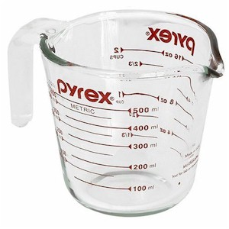
Liquid Measuring Cup
Used for measuring liquids like water, milk, juice, etc.
Available in pint, quart, and gallon sizes

Slide 4
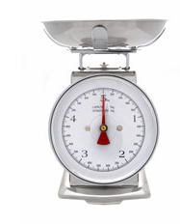
Scales
Used to weigh ingredients for preparation and portion control.
May be spring-type, balance beam, or electronic.
Important for accurate recipes.

Slide 5
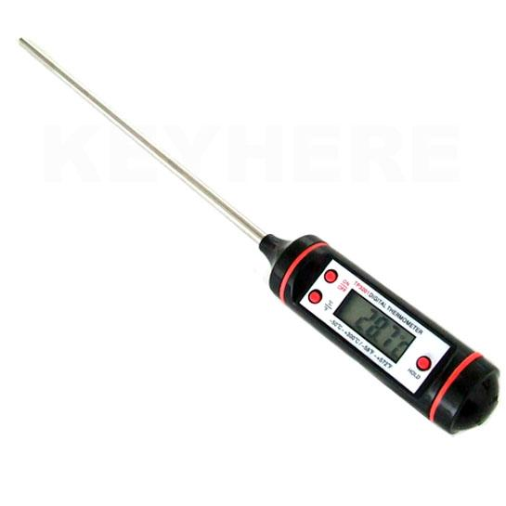
Thermometers
An instant-read thermometer is used to measure foods’ internal temperature for proper and safe cooking.
Candy and deep-fat frying thermometers are also useful.

Slide 6
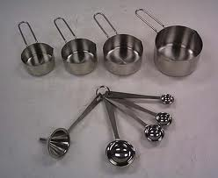
Dry Measuring Cups and Spoons
Used to measure dry ingredients such as sugar, flour, ground nuts, and spices.
Also used to measure viscous, sticky items like honey and peanut butter.

Slide 7
Sieves and Strainers
Flour Sifter
Sieves and Strainers
Colander
Fine Mesh Sieve

Slide 8
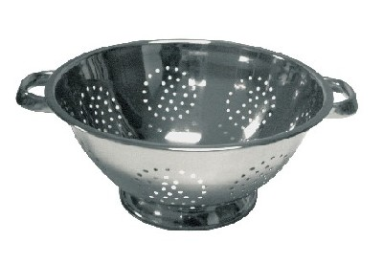
Colander
A bowl with holes and handles used to strain things like pasta and beans.
Available in a variety of sizes and materials.

Slide 9
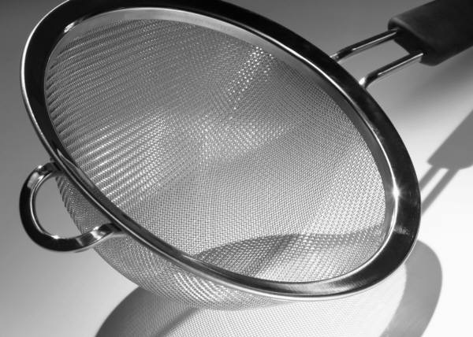
Fine Mesh Sieve
Used to dust, sprinkle, or sift flour, powdered sugar, or other dry ingredients onto work areas or foods.
It can also be used to drain liquid away from foods or strain lumps out of things like soup or homemade pie filling.

Slide 10
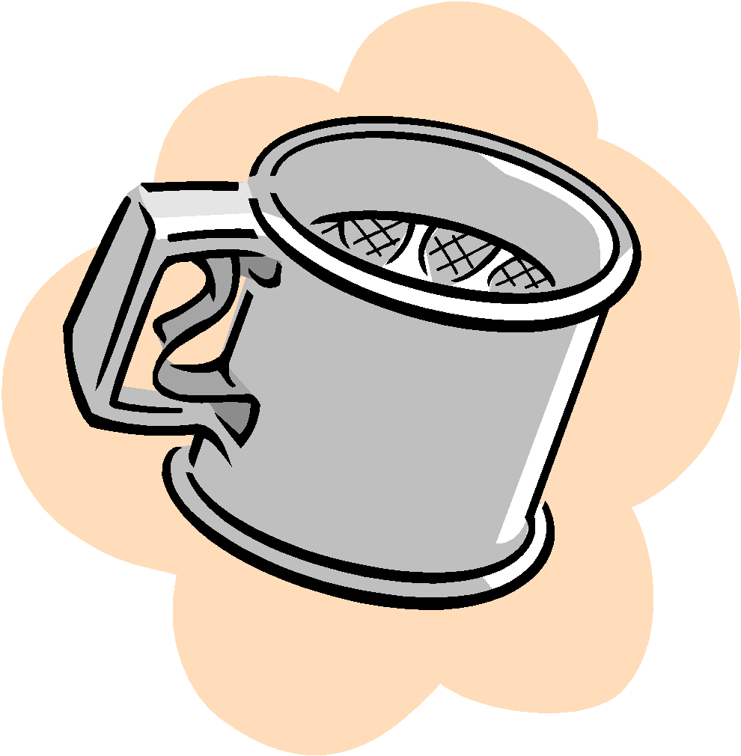
Flour Sifter
Used to sift flour or other dry ingredients in order to remove lumps.
Helps keep you from over mixing batters and developing too much gluten.

Slide 11
Pots and Pans
Stockpot
Griddle
Sauce Pan
Pots and Pans
Frying Pan
Sauce Pot

Slide 12
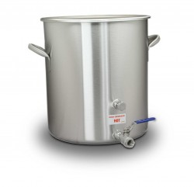
Stockpot
Large pot that is taller than it is wide with straight sides.
Some have a spigot at the base so liquid can be drained off without lifting the heavy pot.

Slide 13
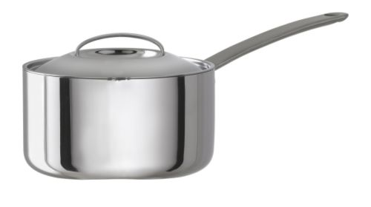
Sauce Pan
This pan has straight sides and a single, long handle.

Slide 14
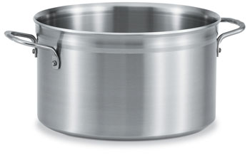
Sauce Pot
Similar in shape to a stockpot, but not as large.
Has straight sides and two loop handles for lifting.

Slide 15
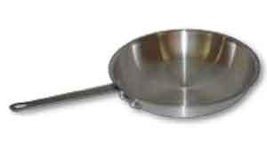
Saute Pan
A shallow skillet with sloping sides and a single long handle.

Slide 16
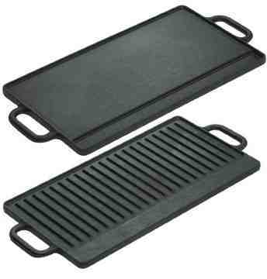
Griddle
A heavy round or rectangular surface for making flat items like pancakes and burgers.
Flat with no sides and can be built directly into the stove.
May have grooves or indentations around the edge to allow grease to drain away.

Slide 17
Other Tools
Rolling Pin
Pastry Brush
Whisk
Kitchen Spoons
Pastry Blender
Cutting Board
Wooden Spoon
Rubber Spatula
Tongs
Ladle
Scoops
Spatula
Grater

Slide 18
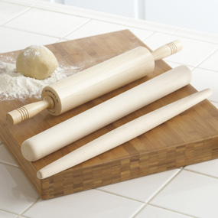
Rolling Pins
Used to roll out dough into a thin sheet, such as cookie dough, pizza dough, and pasta dough.

Slide 19
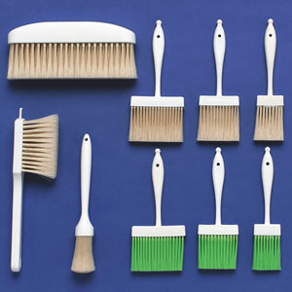
Pastry Brush
Pastry brushes are used to brush items with egg wash, glaze, etc.
Larger bench brushes are used to brush flour from tabletops and from the surface of dough.

Slide 20
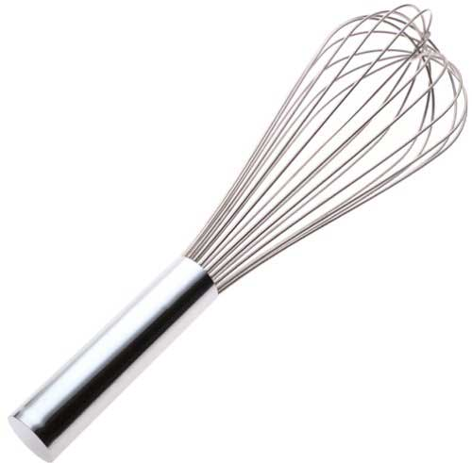
Whisk
Tool made of a series of curved wires attached to a metal rod.
Used to incorporate air into dishes, like whipped cream or meringue, or to get lumps out of soups and sauces.

Slide 21
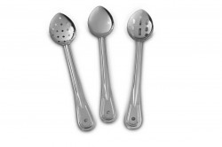
Kitchen Spoons
Metal spoons that can be slotted (slotted spoons), or without slots.
Slotted spoons are used for draining, and those without slots are used for stirring and serving.

Slide 22
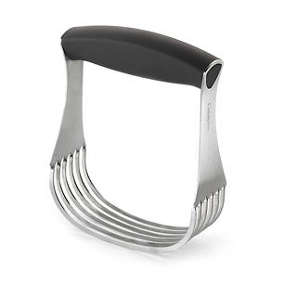
Pastry Blender
Used to “cut” butter into flour or other dry ingredients.
Used to make biscuits and pies.

Slide 23
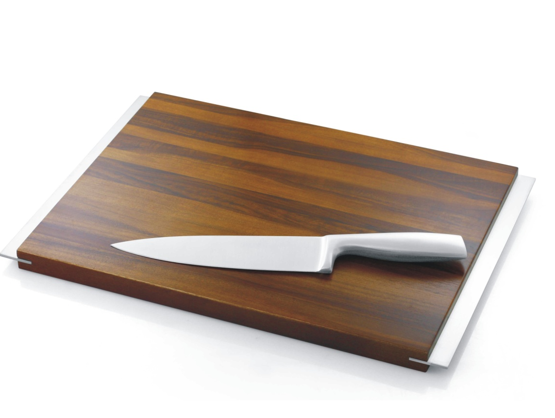
Cutting Board
Surface used to chop vegetables, meats, nuts, and other foods.
Can be made of plastic, glass, or wood.

Slide 24
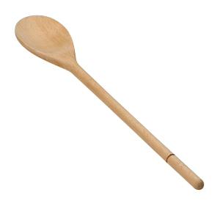
Wooden Spoon
Much like a kitchen spoon, but is made out of wood.
Does not transfer heat easily, meaning it can be more comfortable to hold when stirring hot items compared to a kitchen spoon.
Can burn if left unattended in a hot pot or near a flame.

Slide 25
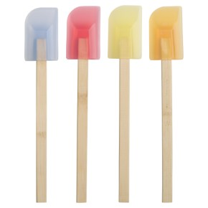
Rubber Spatula
Tool with a rubber scraper on the end.
Used for stirring ingredients, folding, and scraping remaining batters and ingredients out of bowls
Should not be used to stir items in hot pots because they can sometimes melt.

Slide 26
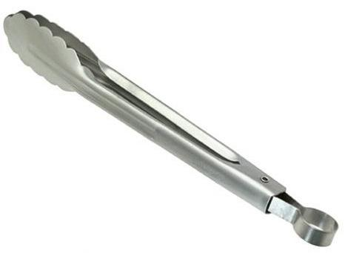
Tongs
Utensils, often metal, used for grilling, serving, transferring food, etc.
Should not be left in a pot or near a heat source because they can get very hot.

Slide 27
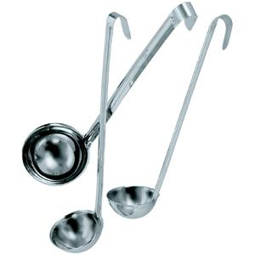
Ladles
A cup-like scoop with a long handle, slightly curved at the top.
Used to scoop out soups, stews, and sauces.
Comes in a variety of sizes.

Slide 28
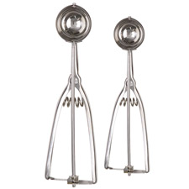
Scoops
Used to scoop ice cream, cookie dough, meatballs, and other items in a uniform way.
Wonderful tool for scooping accurate and uniform amounts.

Slide 29
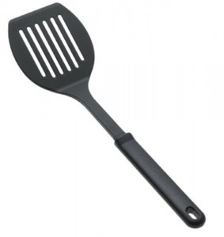
Spatula
A flat square adorned with several cutouts attached to a long handle.
Used to flip items such as pancakes and burgers.
Can be plastic or metal.

Slide 30
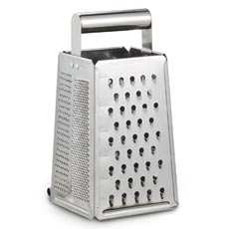
Grater
A rectangular metal box or plane with a series of sharpened holes of varying sizes.
Used to shred cheeses, vegetables, chocolate, and other items.

Slide 31
Baking Pans
Baking Pan
Sheet Pan
Cake Pan
Baking Dishes
Cooling Rack
Muffin Tin

Slide 32
Baking Pan
A square or round dish used to bake things like lasagna, casserole, and brownies.
Made out of glass, metal, or other materials.

Slide 33
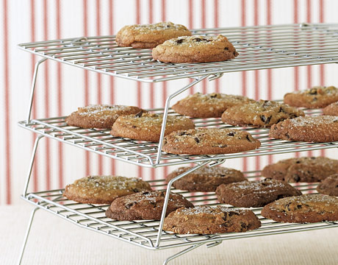
Cooling Rack
Wire racks used to hold baking goods while cooling. They allow air circulation around the items.

Slide 34
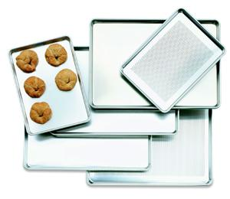
Sheet Pan
A shallow, rectangular pan for baking sheet cakes, cookies, rolls, and other baked goods.

Slide 35
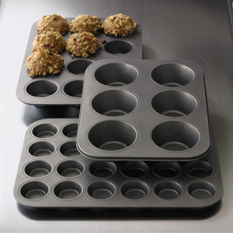
Muffin Pan
Metal baking pan with cup-shaped indentations for baking muffins

Slide 36
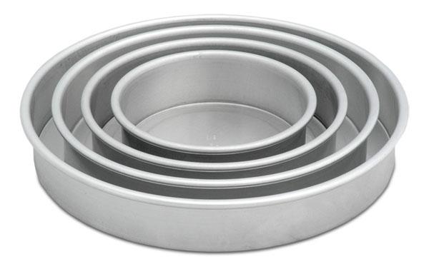
Cake Pans
Most cake pans are round, but other shapes, such as hearts, are available.

Slide 37
Electric Appliances
Hand Mixer
Electrical Appliances
Food Processor
Stand Mixer
Blender

Slide 38
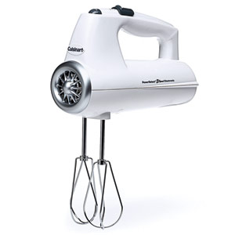
Hand Mixer
A handheld device often used to mix batters and dough.
Comes with different attachments, including dough hooks, beaters, and whisks.

Slide 39
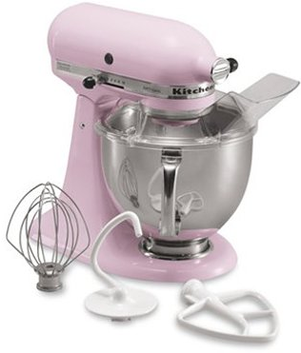
Stand Mixer
A mixer that sits on a countertop when operated.
Can be left to operate on the counter without being held in the hand.
Tools such as spatulas, spoons and fingers should never be placed in the mixer while it is running (can result in injury and amputation).

Slide 40
Comes with different Attachments
Dough Hook: Used to knead bread dough.
Whisk: Used to whip ingredients like egg whites and cream.
Paddle: Used to cream butter and gently mix ingredients.

Slide 41
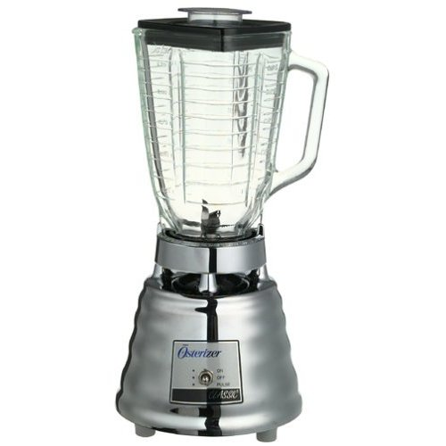
Blender
Has a motor base, a metal, plastic, or glass container, blade, and top.
Used to mix and crush items such as sauces and smoothies.
Hot items should never be blended because steam can build up and cause the blender top to blow off, taking hot liquid with it.

Slide 42
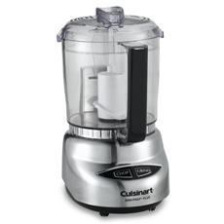
Food Processor
Operates very similarly to a blender but has larger, interchangeable blades.
Sometimes comes with grater and dough attachments.
Used to chop, puree, and mix items.
Depending on the use, can be much more efficient than a blender.

