Slide 1
GMO’s

Slide 3
What does the acronym stand for?
Do you know what gmo’s are?

Slide 4
Vocabulary 4-square
GMO:
Genetically Modified Foods
An organism whose genetic characteristics have been altered by the insertion of a modified gene from another organism using the techniques of genetic engineering.

Slide 5
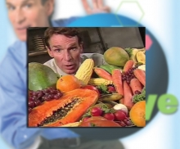
Let’s learn more about the risks & benefits of GMO’s
View The Eyes of nye: genetically modified foods
https://www.youtube.com/watch?v=GKm2Ch3-Myg

Slide 6
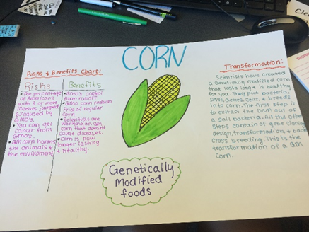
Gmo mini-project
Showcase characteristics of a gmo food

Slide 7
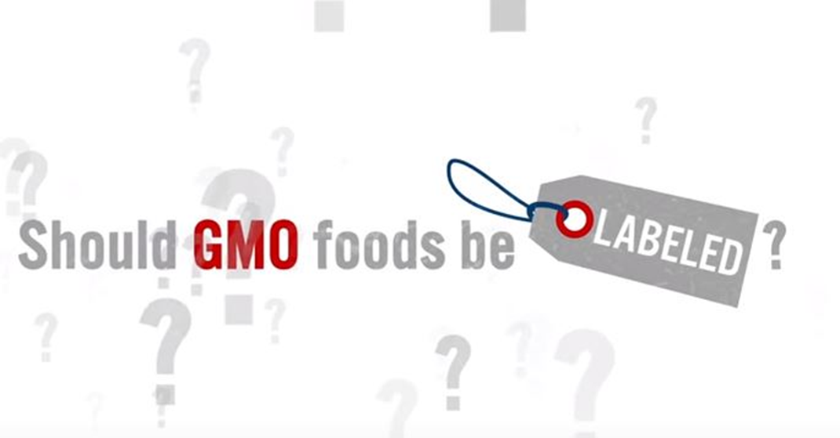
GMO CONTROVERSY…
Read the article “Pros & cons: Is it time to label gmo foods?”
Complete pro/con graphic organizer

Slide 8
GMO’s and Labeling Writing Prompt

